Slide 1
Chapter 5
B2B E-Commerce:
Selling and Buying in Private E-Markets

Slide 2
Learning Objectives
Describe the B2B field.
Describe the major types of B2B models.
Discuss the characteristics of the sell-side marketplace, including auctions.
Describe the sell-side intermediary models.
Describe the characteristics of the buy-side marketplace and e-procurement.
Explain how reverse auctions work in B2B.

Slide 3
Learning Objectives
Describe B2B aggregation and group purchasing models.
Describe other procurement methods.
Explain how B2B administrative tasks can be automated.
Describe infrastructure and standards requirements for B2B.
Describe Web EDI, XML, and Web Services.

Slide 4
Concepts, Characteristics, and Models of B2B EC
business-to-business e-commerce (B2B EC)
Transactions between businesses conducted electronically over the Internet, extranets, intranets, or private networks; also known as eB2B (electronic B2B) or just B2B

Slide 5
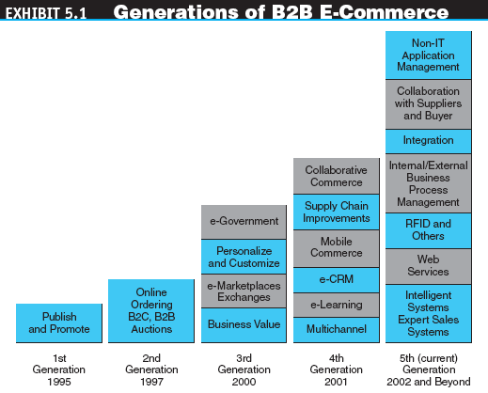
Concepts, Characteristics, and Models of B2B EC

Slide 6
Concepts, Characteristics, and Models of B2B EC
The Basic Types of B2B Transactions and Activities
  Sell-side
  Buy-side
  Exchanges
  Supply chain improvements and collaborative commerce

Slide 7
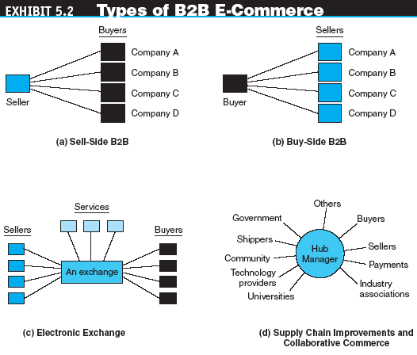
Concepts, Characteristics, and Models of B2B EC

Slide 8
Concepts, Characteristics, and Models of B2B EC
The Basic Types of B2B E-Marketplaces and Services
  One-to-many and many-to-one: private e-marketplaces
    company-centric EC
    E-commerce that focuses on a single company’s buying needs (many-to-one, or buy-side) or selling needs (one-to-many, or sell-side)
    private e-marketplaces
    Markets in which the individual sell-side or buy-side company has complete control over participation in the selling or buying transaction

Slide 9
Concepts, Characteristics, and Models of B2B EC
  Intermediaries
  Many-to-many: exchanges
    exchanges (trading communities or trading exchanges)
    Many-to-many e-marketplaces, usually owned and run by a third party or a consortium, in which many buyers and many sellers meet electronically to trade with each other
    public e-marketplaces
    Third-party exchanges that are open to all interested parties (sellers and buyers)

Slide 10
Concepts, Characteristics, and Models of B2B EC
  Supply chain activities and collaborative commerce
  B2B2C
B2B Characteristics
  Parties to the transaction: sellers, buyers, and intermediaries
    online intermediary
    An online third party that brokers a transaction online between a buyer and a seller; may be virtual or click-and-mortar

Slide 11
Concepts, Characteristics, and Models of B2B EC
  Types of transactions
    spot buying
    The purchase of goods and services as they are needed, usually at prevailing market prices
    strategic (systematic) sourcing
    Purchases involving long-term contracts that usually are based on private negotiations between sellers and buyers

Slide 12
Concepts, Characteristics, and Models of B2B EC
  Types of materials traded
    direct materials
    Materials used in the production of a product (e.g., steel in a car or paper in a book)
    indirect materials
    Materials used to support production (e.g., office supplies or light bulbs)
    MRO (maintenance, repair, and operation)
    Indirect materials used in activities that support production

Slide 13
Concepts, Characteristics, and Models of B2B EC
  Direction of trade
    vertical marketplaces
    Markets that deal with one industry or industry segment (e.g., steel, chemicals)
    horizontal marketplaces
    Markets that concentrate on a service, materials, or a product that is used in all types of industries (e.g., office supplies, PCs)

Slide 14
Concepts, Characteristics, and Models of B2B EC
SUPPLY CHAIN RELATIONSHIPS IN B2B
  The supply chain process consists of a number of interrelated subprocesses and roles
    Acquisition of materials from suppliers
    Processing of a product or service
    Packaging it and moving it to distributors and retailers
    The eventual purchase of a product by the end consumer
  A B2B private e-marketplace provides a company with high supply chain power and high capabilities for online interactions

Slide 15
Concepts, Characteristics, and Models of B2B EC
Virtual Service Industries in B2B
  Travel and hospitality services
  Real estate
  Financial services
  Online stock trading
  Online financing
  Other online services

Slide 16
Concepts, Characteristics, and Models of B2B EC
The Benefits of B2B
  Creates new sales (purchase) opportunities
  Eliminates paper and reduces administrative costs
  Expedites processing and reduces cycle time
  Lowers search costs and time for buyers to find products and vendors
  Increases productivity of employees dealing with buying and/or selling
  Reduces errors and improves quality of services
  Makes product configuration easier
  Reduces marketing and sales costs (for sellers)

Slide 17
Concepts, Characteristics, and Models of B2B EC
The Benefits of B2B
  Reduces inventory levels and costs
  Enables customized online catalogs with different prices for different customers
  Increases production flexibility, permitting just-in-time delivery
  Reduces procurement costs (for buyers)
  Facilitates customization via configuration (e.g., at Cisco)
  Provides for efficient customer service
  Increases opportunities for collaboration

Slide 18
Concepts, Characteristics, and Models of B2B EC
The Limitations of B2B
  Channel conflict
  Operation of public exchanges

Slide 19
One-to-Many:
Sell-Side E-Marketplaces
sell-side e-marketplace
A Web-based marketplace in which one company sells to many business buyers from e-catalogs or auctions, frequently over an extranet
  B2B Sellers
  Customer Service

Slide 20
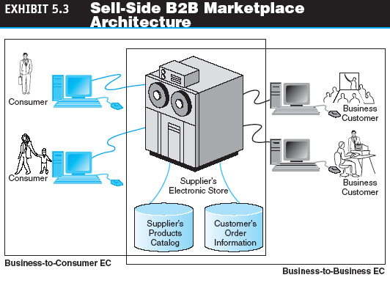
One-to-Many:
Sell-Side E-Marketplaces

Slide 21
One-to-Many:
Sell-Side E-Marketplaces
Direct Sales from Catalogs
  Configuration and customization
  Benefits and limitations of direct sales from catalogs
    The benefits of direct sales are similar to that of B2C
    Limitations
      How to find a buyer
      Channel conflicts with their existing distribution systems
      The cost to the customers can be high

Slide 22
One-to-Many:
Sell-Side E-Marketplaces
Direct Sales: The Example of Cisco Systems
  Customer service
  Online ordering by customers
  Tracking order status
    Benefits
      Reduced operating costs for order taking
      Improved quality
      Reduced technical support staff cost
      Reduced software distribution costs
      Faster service

Slide 23
Selling via
Intermediaries and Distributors
Manufacturers frequently use intermediaries to distribute their products to a large number of buyers, known as distributors
The intermediaries usually buy products from many vendors and aggregate them into one catalog from which they sell
Now, many of these distributors also are selling online

Slide 24
Selling via Auctions
Using Auctions on the Sell Side
  Revenue generation
  Cost savings
  Increased “stickiness”
  Member acquisition and retention

Slide 25
Selling via Auctions
Auctioning from the Company’s Own Site
  Why should a company pay a commission to an intermediary if the intermediary cannot provide the company with added value
  If a company decides to auction from its own site, it will have to pay for infrastructure and operate and maintain the auction site

Slide 26
Selling via Auctions
Using Intermediaries in Auctions
  Benefits
    No additional resources are required
    No hiring costs or opportunity costs associated with the redeployment of corporate resources
    Offer fast time-to-market
    Billing and collection efforts, are handled by the intermediary rather than the company

Slide 27
One-from-Many: Buy-Side E-Marketplaces and E-Procurement
buy-side e-marketplace
A corporate-based acquisition site that uses reverse auctions, negotiations, group purchasing, or any other e-procurement method

Slide 28
One-from-Many: Buy-Side E-Marketplaces and E-Procurement
Six Main Types of E-Procurement
  e-sourcing
  e-tendering
  e-reverse auctioning
  e-informing
  Web-based ERP (electronic resource planning)
  e-MRO (maintenance, repair and operating)

Slide 29
One-from-Many: Buy-Side E-Marketplaces and E-Procurement
Inefficiencies in Traditional Procurement Management
  procurement management
  The planning, organizing, and coordination of all the activities relating to purchasing goods and services needed to accomplish the mission of an organization
  maverick buying
  Unplanned purchases of items needed quickly, often at non-prenegotiated higher prices

Slide 30
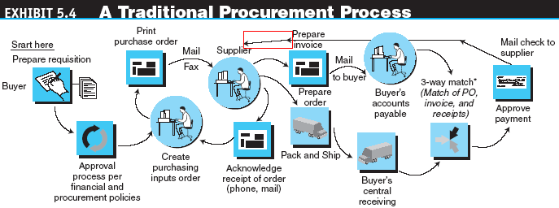
One-from-Many: Buy-Side E-Marketplaces and E-Procurement

Slide 31
One-from-Many: Buy-Side E-Marketplaces and E-Procurement
e-procurement
The electronic acquisition of goods and services for organizations

Slide 32
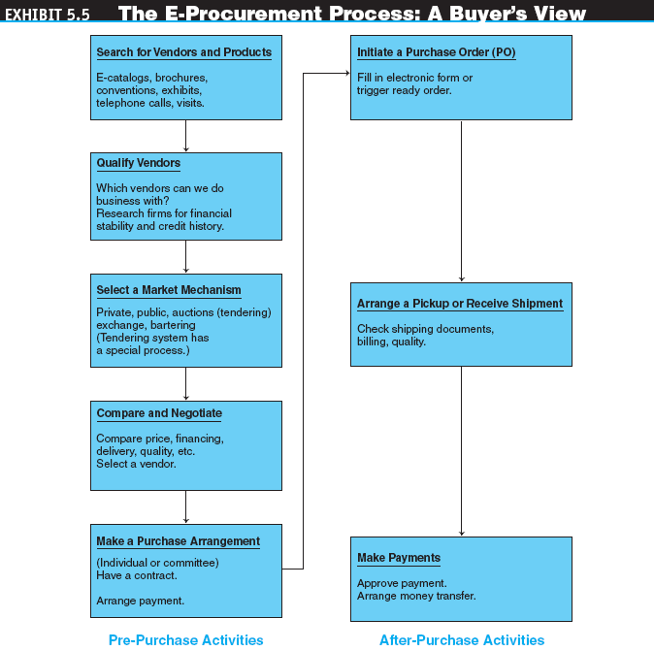
One-from-Many: Buy-Side E-Marketplaces and E-Procurement

Slide 33
One-from-Many: Buy-Side E-Marketplaces and E-Procurement
The Goals and Benefits of E-Procurement
  Increasing the productivity of purchasing agents
  Lowering purchase prices
  Improving information flow and management
  Minimizing the purchases made from non-contract vendors
  Improving the payment process and savings due to expedited payments
  Establishing efficient, collaborative supplier relations
  Ensuring delivery on time, every time
  Slashing order-fulfillment and processing times by leveraging automation

Slide 34
One-from-Many: Buy-Side E-Marketplaces and E-Procurement
The Goals and Benefits of E-Procurement
  Reducing the skill requirements and training needs of purchasing agents
  Reducing the number of suppliers
  Streamlining the purchasing process,
  Streamlining invoice reconciliation and dispute resolution
  Reducing the administrative processing cost per order
  Finding new suppliers and vendors that can provide goods and services faster and/or cheaper (improved sourcing)
  Integrating budgetary controls into the procurement process
  Minimizing human errors in the buying or shipping processes
  Monitoring and regulating buying behavior

Slide 35
One-from-Many: Buy-Side E-Marketplaces and E-Procurement
Implementing E-Procurement
  Fitting e-procurement into the company’s EC strategy
  Reviewing and changing the procurement process itself
  Providing interfaces between e-procurement and integrated enterprisewide information systems, such as ERP or supply chain management
  Coordinating the buyer’s information system with that of the sellers
  Consolidating the number of regular suppliers and integrating with their information systems and, if possible, with their business processes

Slide 36
One-from-Many: Buy-Side E-Marketplaces and E-Procurement
e-sourcing
The process and tools that electronically enable any activity in the sourcing process, such as quotation/tender submission and response, e-auctions, online negotiations, and spending analyses

Slide 37
Buy-Side E-Marketplaces:
Reverse Auctions
request for quote (RFQ)
The “invitation” to participate in a tendering (bidding) system

Slide 38
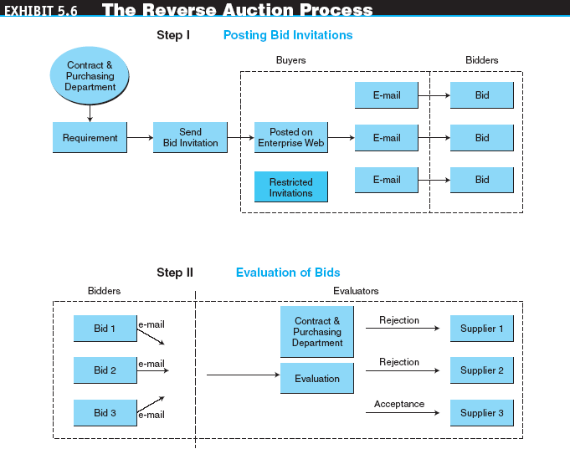
Buy-Side E-Marketplaces:
Reverse Auctions

Slide 39
Other E-Procurement Methods
internal procurement marketplace
The aggregated catalogs of all approved suppliers combined into a single internal electronic catalog
desktop purchasing
Direct purchasing from internal marketplaces without the approval of supervisors and without the intervention of a procurement department

Slide 40
Other E-Procurement Methods
group purchasing
The aggregation of orders from several buyers into volume purchases so that better prices can be negotiated
  Internal aggregation
  External aggregation

Slide 41
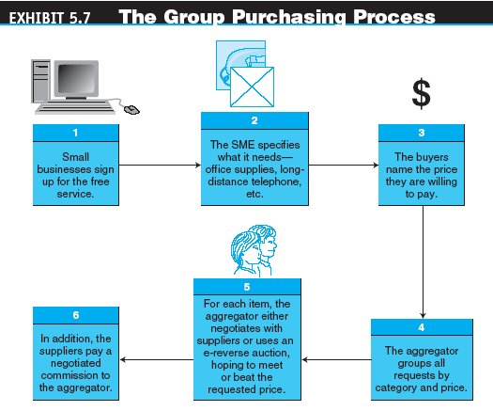
Other E-Procurement Methods

Slide 42
Other E-Procurement Methods
Buying from E-Distributors
Purchasing Direct Goods
Electronic Bartering
  bartering exchange
  An intermediary that links parties in a barter; a company submits its surplus to the exchange and receives points of credit, which can be used to buy the items that the company needs from other exchange participants
Buying in Exchanges and Industrial Malls

Slide 43
Automating B2B Tasks
Contract Management
  Contract-management software can:
    Reduce contract negotiation time and efforts
    Facilitate inter- and intracompany contract analysis and development
    Provide for proactive contract compliance management
    Enable enterprisewide standardization of contracts
    Improve understanding of contract-related risks
    Provide a more efficient approval process

Slide 44
Automating B2B Tasks
Spend Management
  Tools and features may be found in spend-management software include:
    A data warehouse repository designed to manage data from multiple data sources
    Data management of contracts, supplier catalogs, and product content
    Data management of pricing
    Detailed standard and ad-hoc purchasing activity analysis and report tools
    Updates, notifications, and alerts regarding purchasing

Slide 45
Automating B2B Tasks
Sourcing Management and Negotiation
  Tools and features may be found in sourcing management software include:
    Bid comparison, including exports of detailed bid data
    User management functions that eliminate data redundancy, simplify data management, and reduce risk to data integrity
    Weighted scoring of parameters to calculate the total value offered by suppliers
    Total merchandise purchased cost model with bids winners selection and ranking
    Reverse auctions and sealed bids, with a full set of features such as proxy bids and bid-time extensions
    Negotiation support tools

Slide 46
Infrastructure, Integration, and Software
Agents In B2B EC
Infrastructure for B2B
  electronic data interchange (EDI)
  The electronic transfer of specially formatted standard business documents, such as bills, orders, and confirmations, sent between business partners
  value-added networks (VANs)
  Private, third-party managed networks that add communications services and security to existing common carriers; used to implement traditional EDI systems
  Internet-based (Web) EDI
  EDI that runs on the Internet and is widely accessible to most companies, including SMEs

Slide 47
Infrastructure, Integration, and Software
Agents In B2B EC
Integration
  Integration with the existing internal infrastructure and applications
  Integration with business partners

Slide 48
Infrastructure, Integration, and Software
Agents In B2B EC
The Role of Standards, Especially XML, in B2B Integration
  XML (eXtensible Markup Language)
  Standard (and its variants) used to improve compatibility between the disparate systems of business partners by defining the meaning of data in business documents

Slide 49
Infrastructure, Integration, and Software
Agents In B2B EC
  XBRL
  A version of XML for capturing financial information throughout a business’s information processes. XBRL makes it possible to format reports that need to be distributed to shareholders, SOX regulators, banks, and other parties. The goal of XBRL is to make the analysis and exchange of corporate information more reliable (trustworthy) and easier to facilitate
  Web Services
  An architecture enabling assembly of distributed applications from software services and tying them together

Slide 50
Managerial Issues
Can we justify the cost of B2B?
Which vendor(s) should we select?
Which B2B model(s) should we use?
Should we restructure our procurement system?
What are the ethical issues in B2B?
Will there be massive disintermediation?
How can trust and loyalty be cultivated in B2B?
How is mobile B2B done?

